Slide 1
colab.research.google.com

Slide 2
Go TO WEBPAGE
https://colab.research.google.com

Slide 3
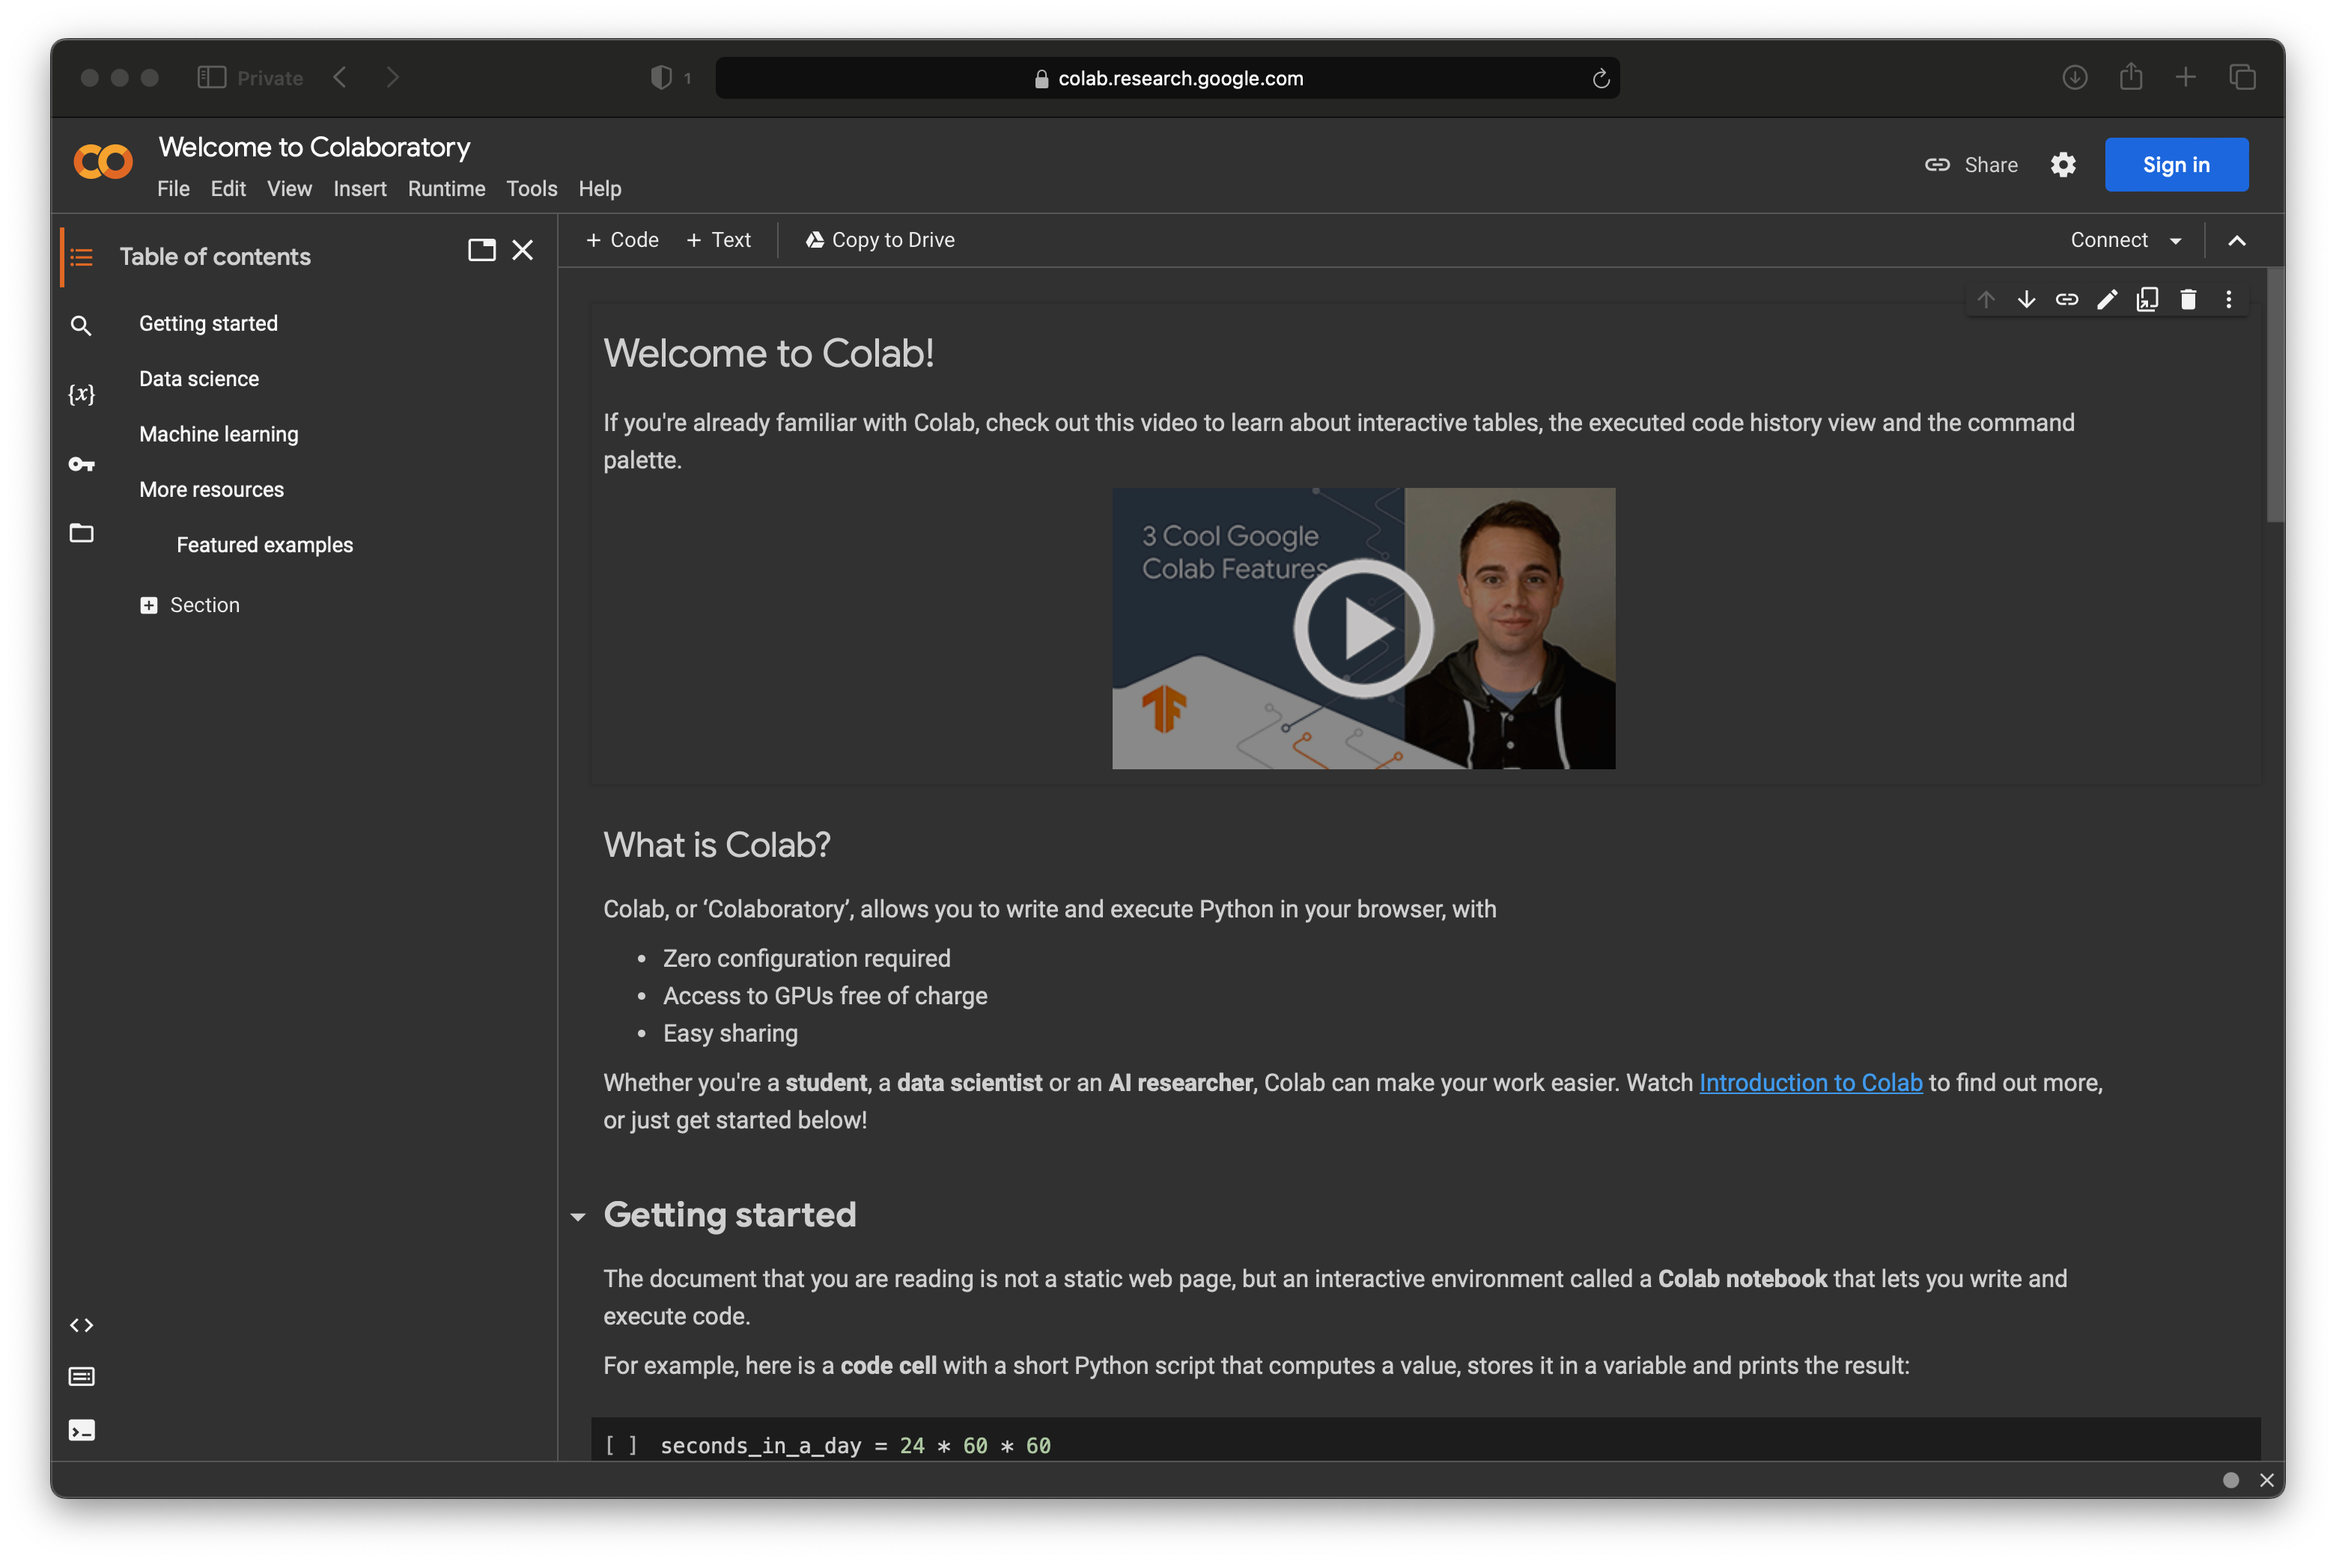

Slide 4
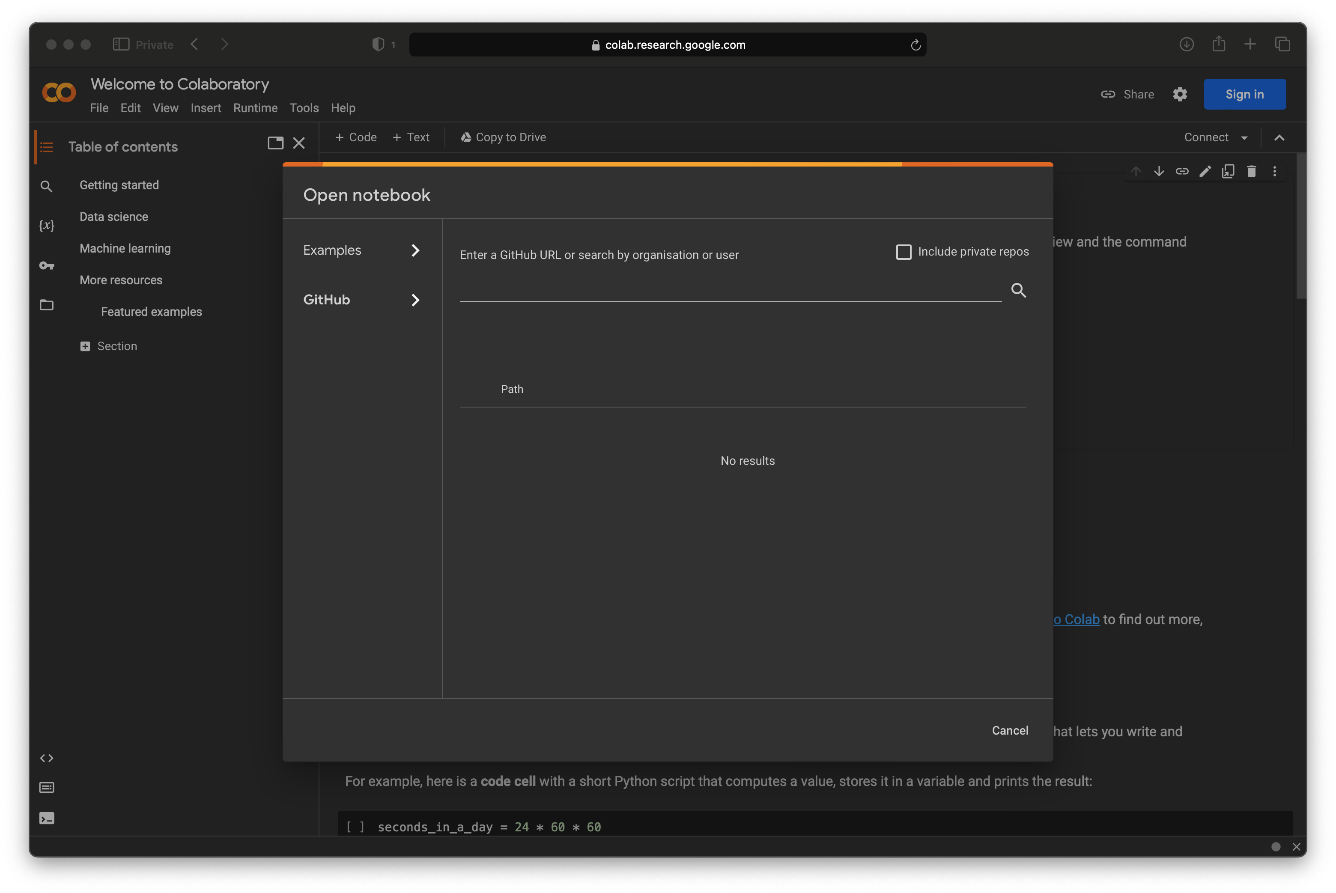
SELECT FILE > OPEN NOTEBOOK

Slide 5



Load the LAB TUTORIAL
From the webpage
Choose File > Open Notebook
Choose GitHub tab
Click ‘Enter a GitHub URL or search …’
Search for the name: bhrionn
At Repository, Choose ‘bhrionn/Corvinus-AI’
Select CaliforniaHousingDataNotebook.ipynb

Slide 6
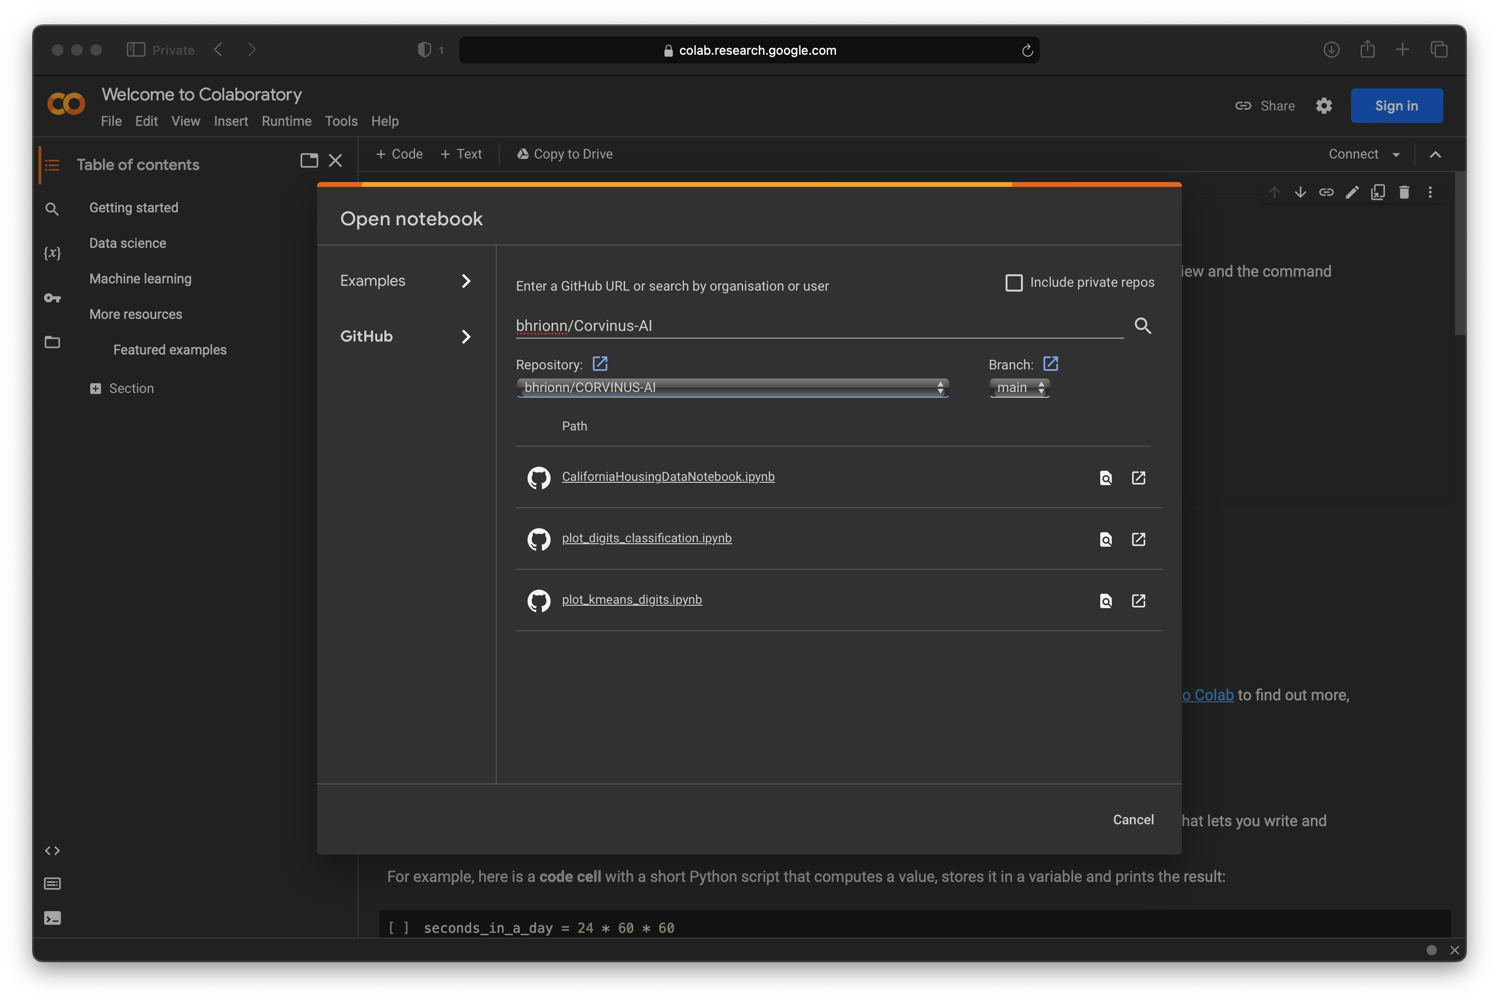




Slide 7
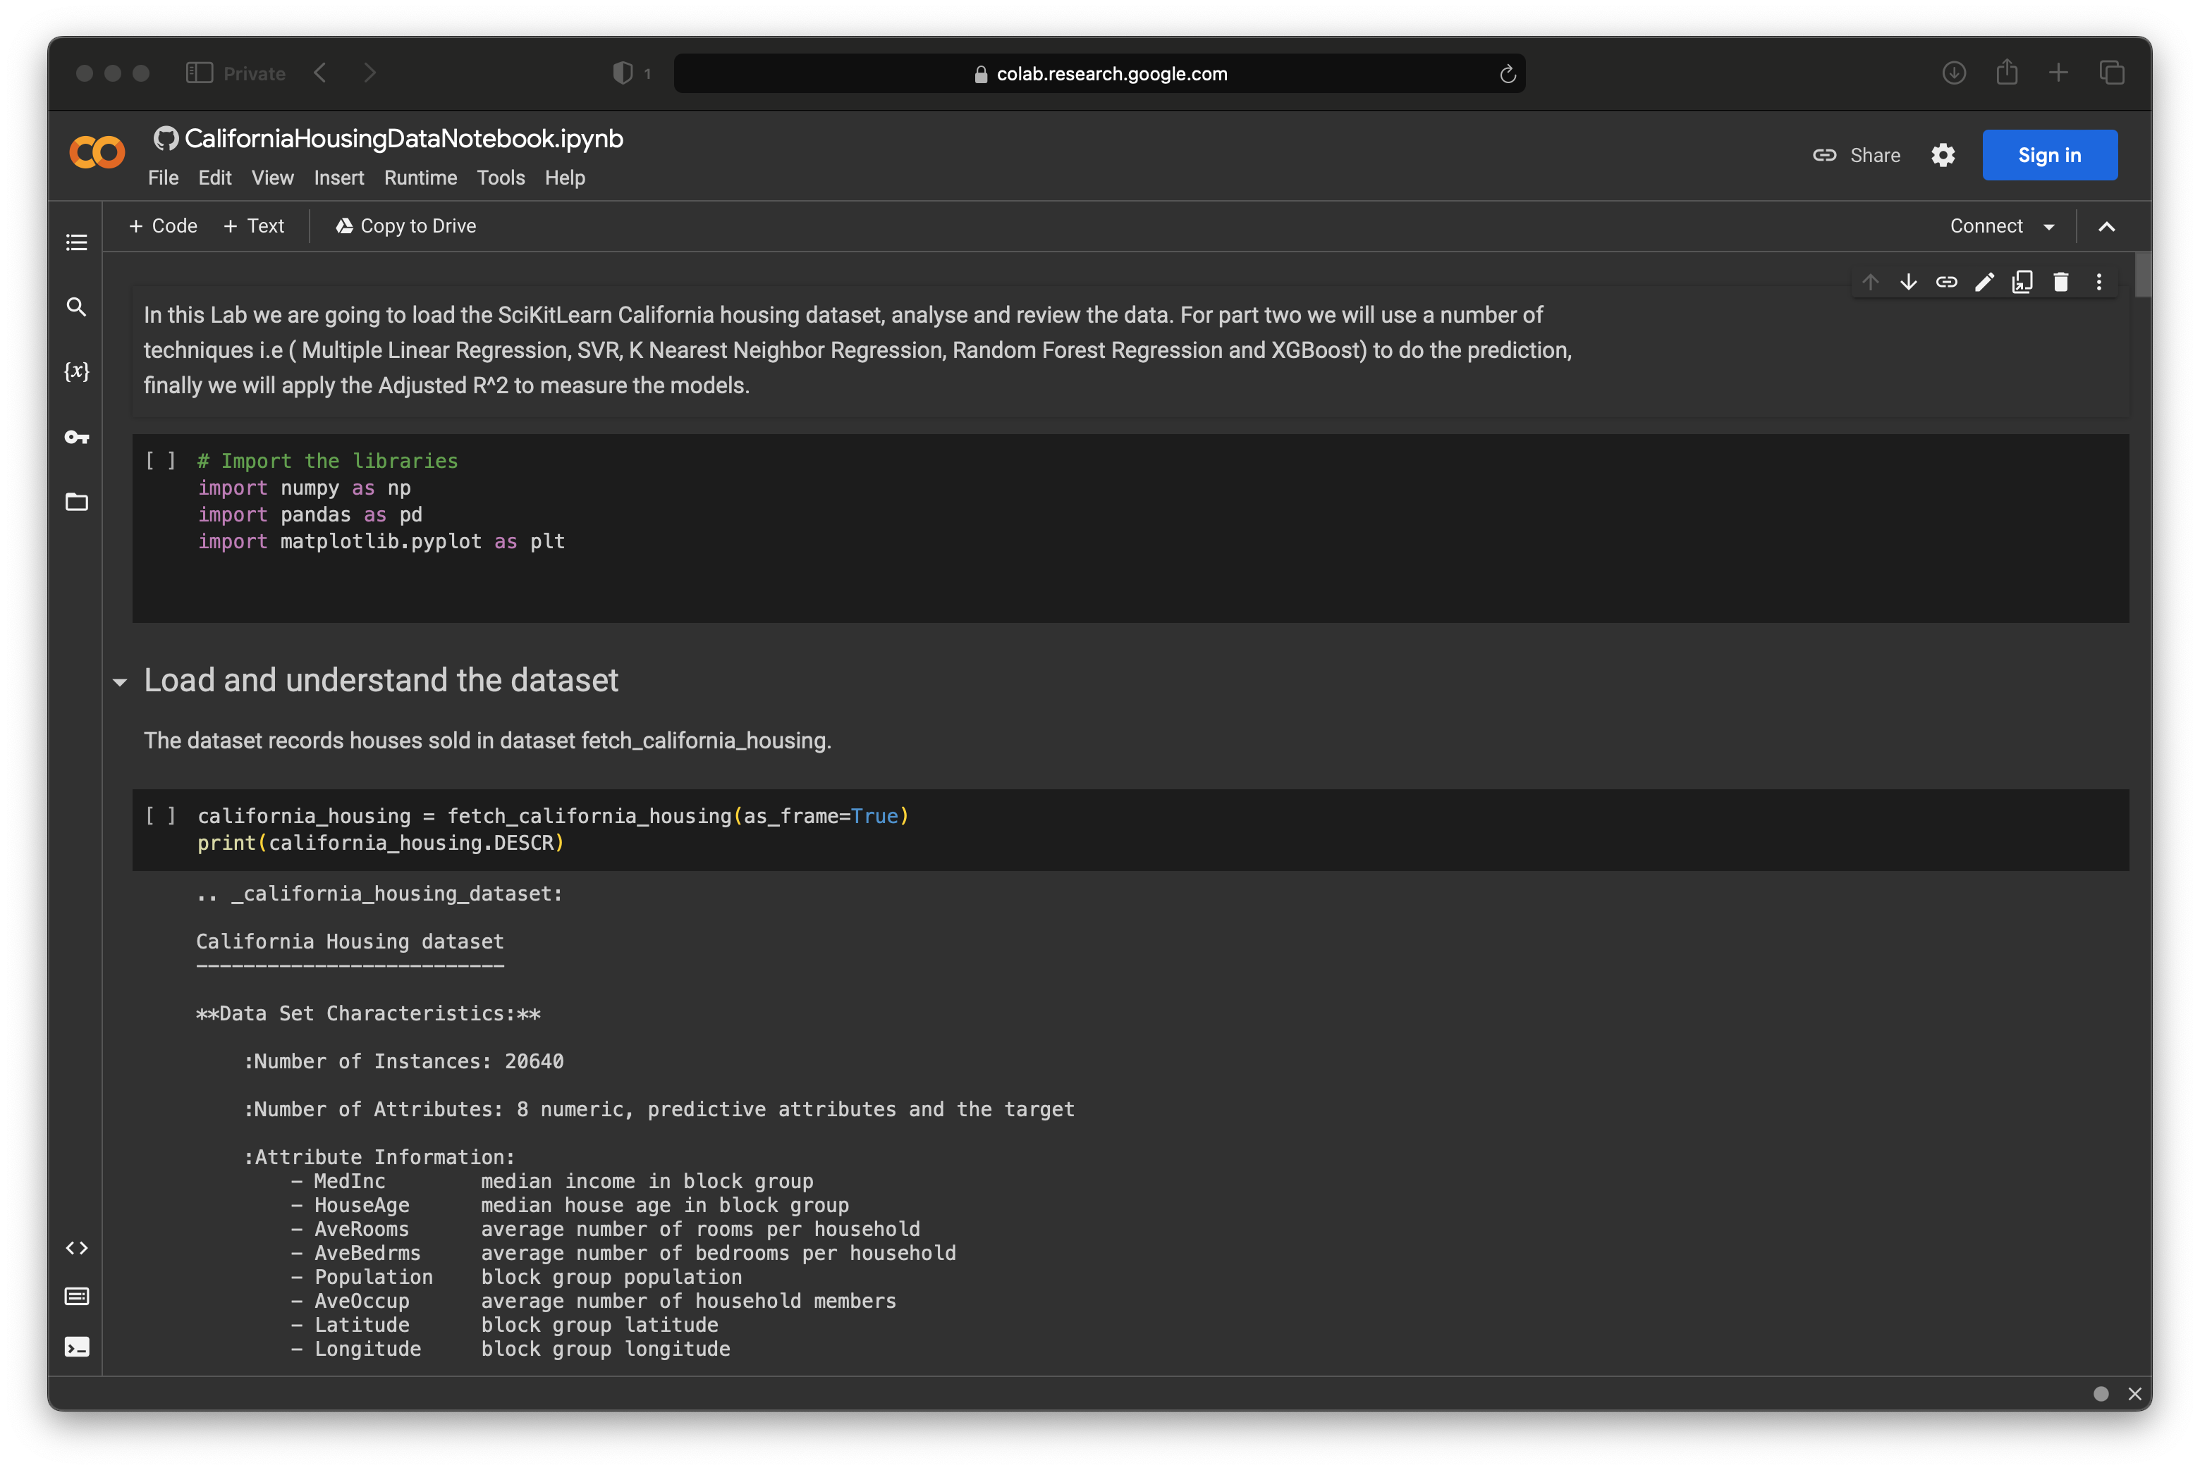


SIGN IN TO GOOGLE ACCOUNT TO RUN THE LAB

Slide 8
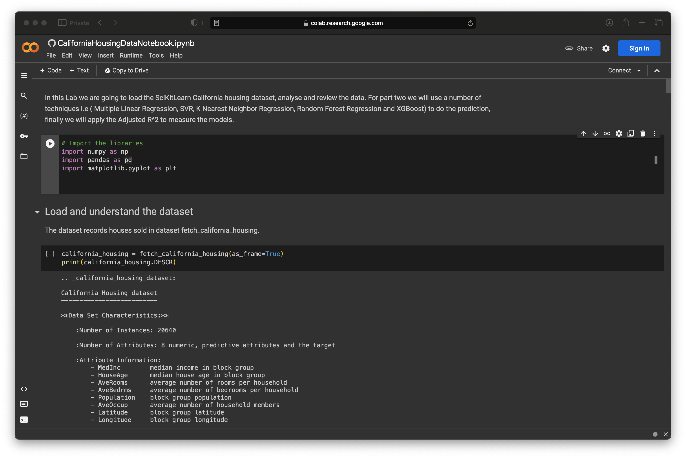
PRESS PLAY BUTTON TO RUN THE CELL

Slide 9
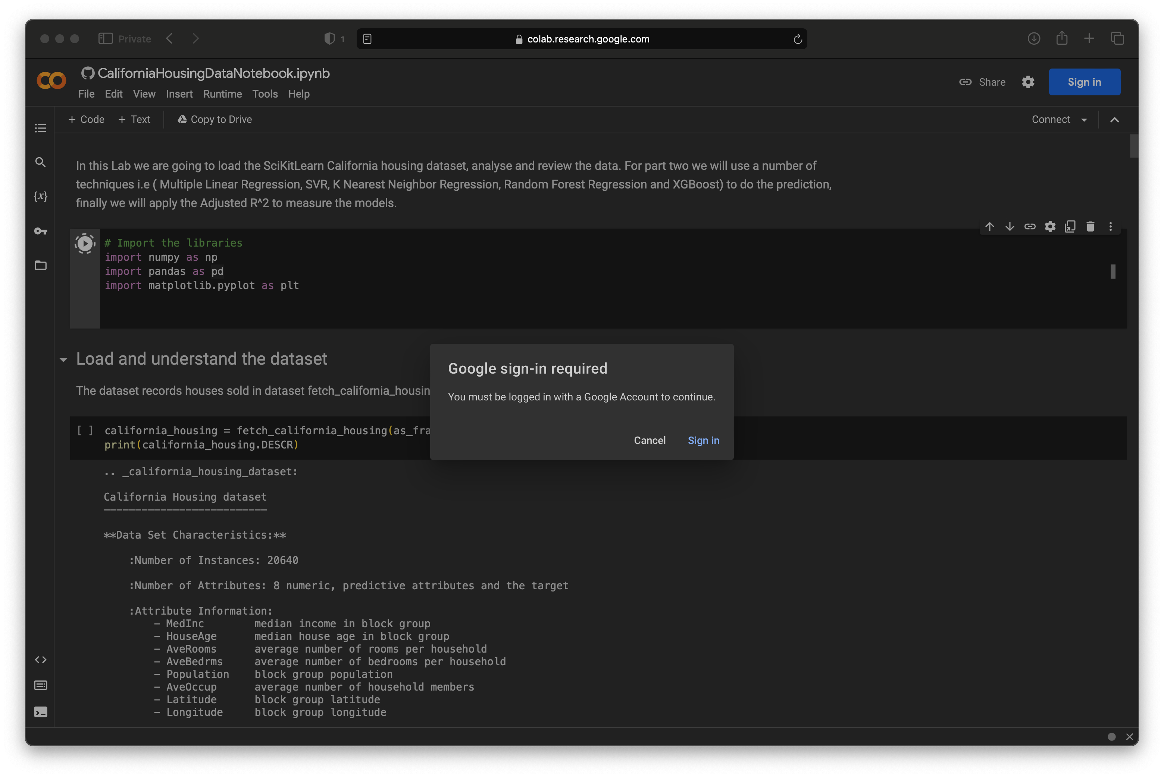



Slide 10
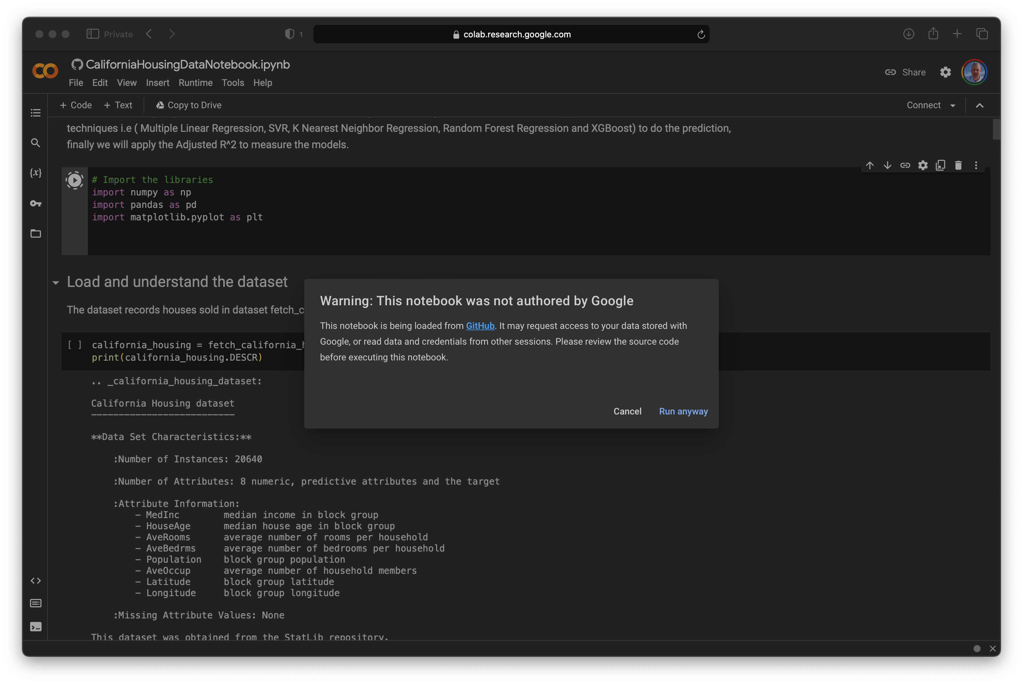


RUN ANYWAY .. AFTER YOU ARE LOGGED IN

Slide 11
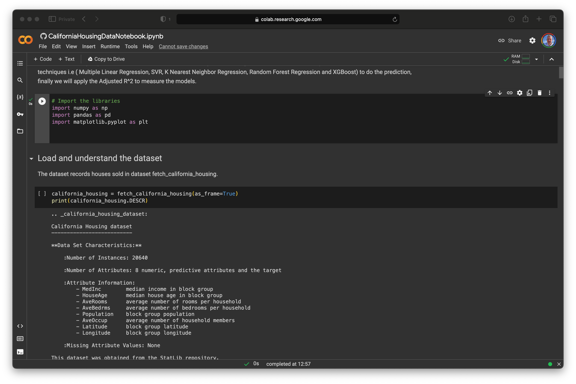


Successfully SETUP when WE SEE CHECK MARK

